Slide 1

Data Analysis of 35 years of Questions & Answers
Team 13 – “The Jeopardy Janes”:
Grace Gumlock, Michelle Lucio, Jessica Schmitz
This slideshow is licensed under a Creative Commons Attribution Non-Commercial 3.0 United States license. For more information about this license see http://creativecommons.org/licenses/by-nc/3.0/ (In short, you can copy, distribute, and adapt this work as long as you give proper attribution and do not charge for it.)

Slide 2
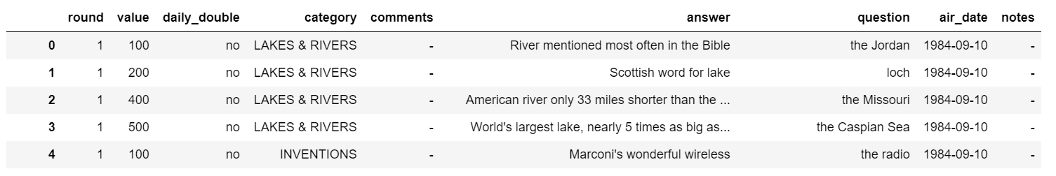
Our Jeopardy Data
350,000+ questions
Seasons 1 -35 from 1984 to 2019
Dataset from Kaggle
https://www.kaggle.com/prondeau/350000-jeopardy-questions
2 available datasets as .tsv files –adult & kid/teen
Only adult dataset used (349,641 rows of data)

Slide 3
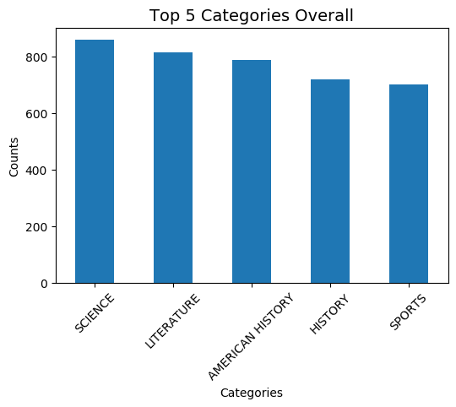
What are The Top Categories of Jeopardy?
Used groupby to sort/count categories
used air date to sort by years
Used .loc to pull out round details
Top 5 Overall
“Science” occurred 830 times
Total of 43,369 Categories
Any Related Categories were treated as Unique
If studying to be on show, these categories would be a great place to start

Slide 4
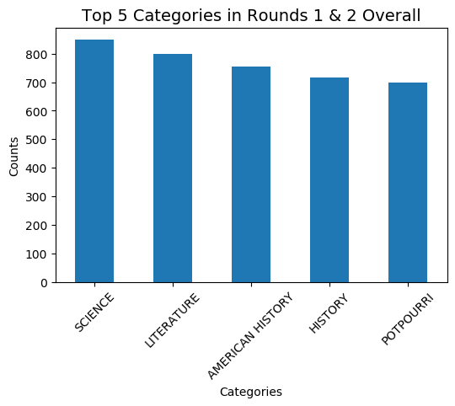
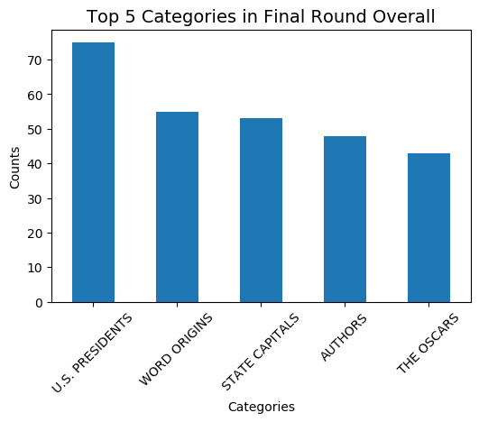
Do Categories Change Between Rounds 1&2 Versus The Final Round?

Slide 5
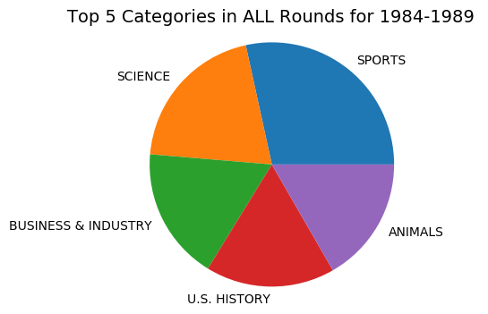
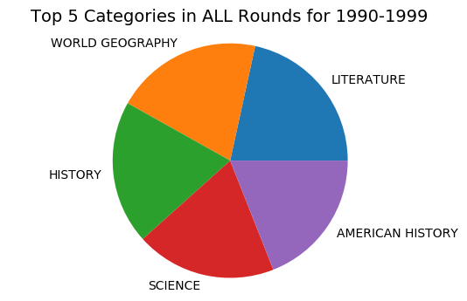
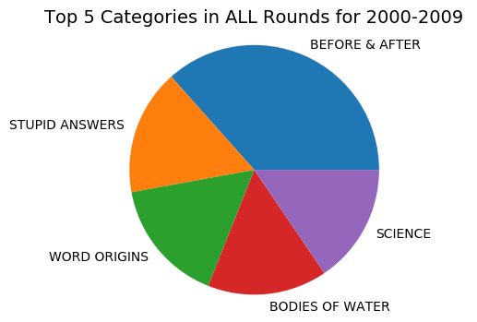
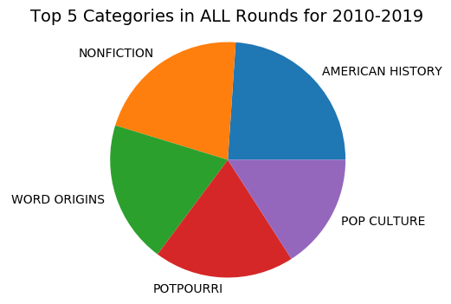
Do Categories Change By The Decades?

Slide 6
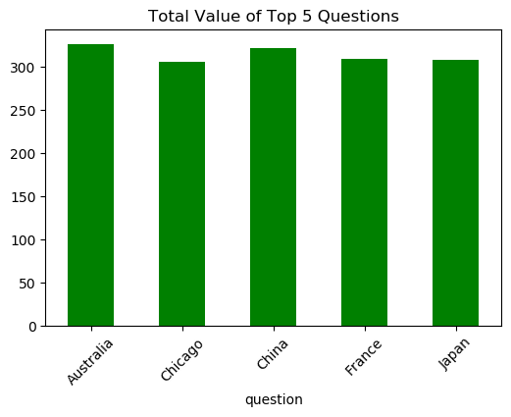
What are the top 5 questions on Jeopardy?
Found the top 5 questions
Australia: 327
China: 322
France: 310
Japan: 308
Chicago: 306
Although my data is limited to the top 5, you can expand the data out and this will help you understand which questions you should study the most.

Slide 7
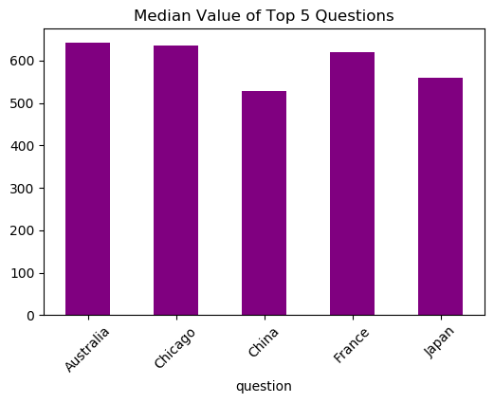
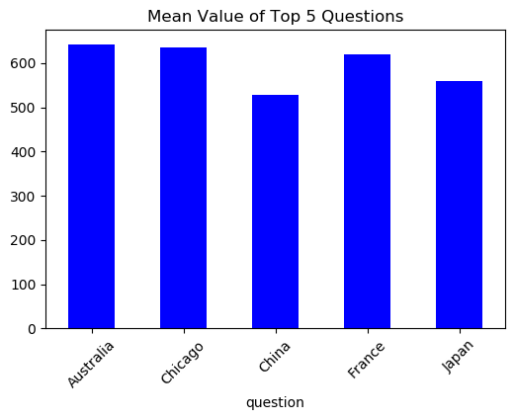
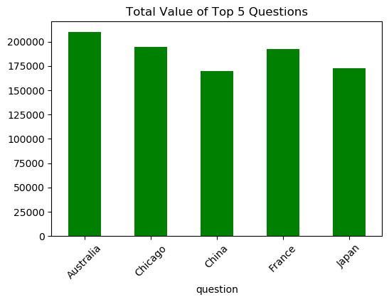
Looking at the top 5 questions, which have the highest value?

Slide 8
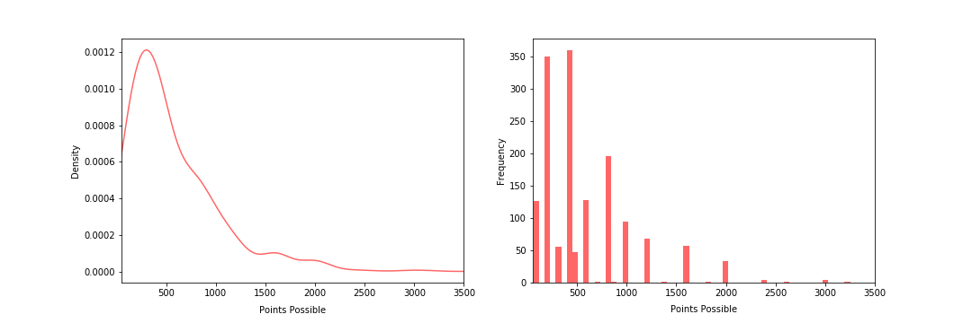
How are the values of the top 5 questions distributed?
Looking at Density of Points Possible
Looking at Frequency of Points Possible

Slide 9
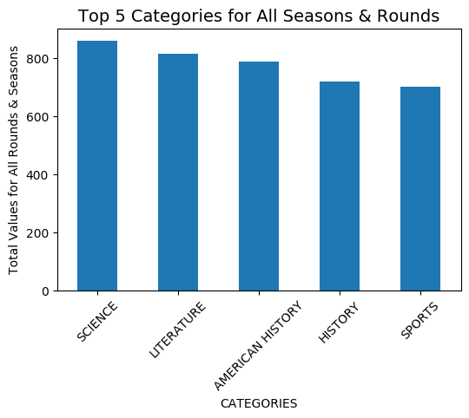
Top 5 Categories Over 35 Seasons

Slide 10
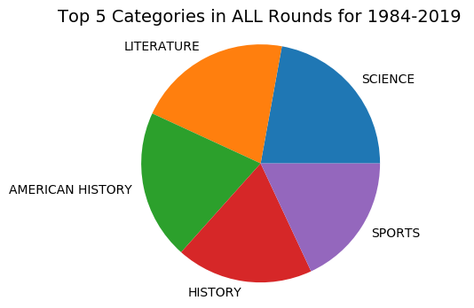
Top 5 Categories in All Rounds Over 35 Seasons

Slide 11
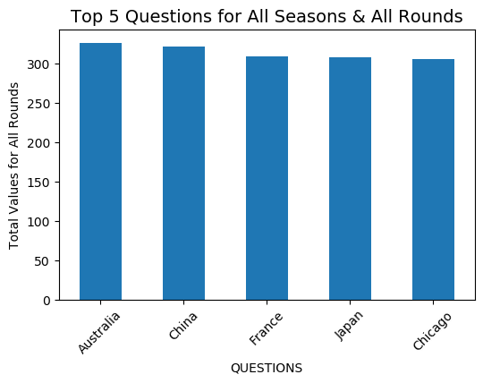
Top 5 Questions for All Seasons & All Rounds

Slide 12
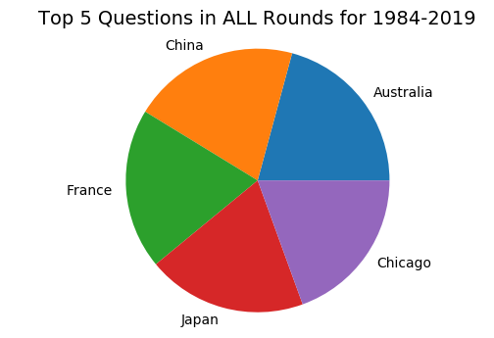
Top 5 Questions in All Rounds & Seasons

Slide 13
FINAL
What Questions or Answers do you have?
(please phrase as a question)

